Slide 1
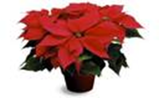
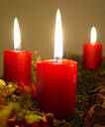
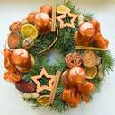
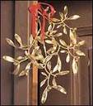
Christmas time
What do you need ?
Do you decorate your house ?
wreath
mistletoe
candles
decoration
electric lights
Christmas tree
chain
bells
Gold balls
holly

Slide 2
Christmas time
What do you need ?
Do you decorate your house ?
wreath
mistletoe
candles
decoration
electric lights
Christmas tree
chain
bells
Gold balls
holly

Slide 3
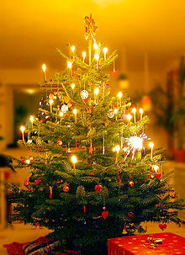
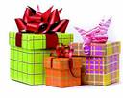
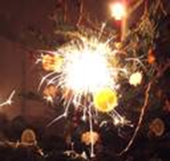
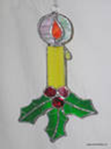
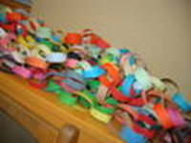
Christmas - Decorate your Christmas tree
What do you put on (under) ?
presents
sparkles
bells
gold balls
candles
decorations
a candle
a Christmas tree
a chain

Slide 4
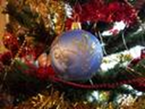
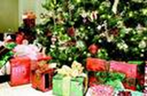
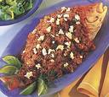
At Christmas
When do you celebrate Christmas ?
What do you decorate ?
When do you open the presents ?
What do you have for Christmas dinner ?
We celebrate Christmas on Christmas Eve - December 24.
We decorate our house (flat) and the Christmas tree.
We open the presents in the afternoon (evening).
We have pea soup,potato salad and roast carp.

Slide 5
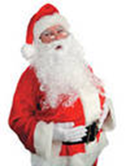
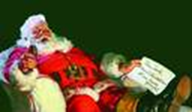
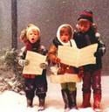
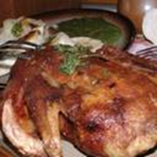
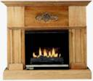
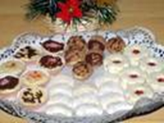
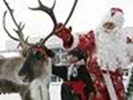
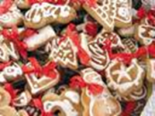
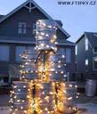
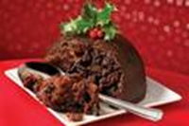
Christmas–what are the other words ?
In the Czech Republic
In Great Britain

Slide 6
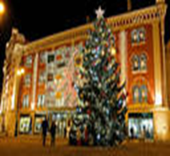
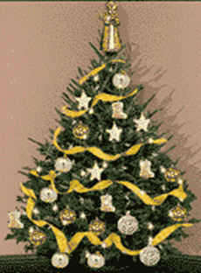
Christmas in the Czech Republic What are the other words ?
1.
1. Father Christmas
2.
2. singing carols
5.
3. roast carp
3.
4. twigs
6.
5.cookies
4.
6.gingerbread

Slide 7
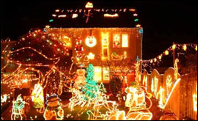
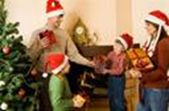
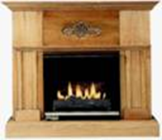
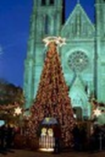
Christmas in Great Britain What are the other words ?
Family
Illuminated house
Santa Claus
Christmas pudding
fireplace
Church
Stokings
Roast turkey
Santa´ s sleigh

Slide 8
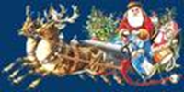
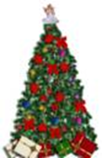
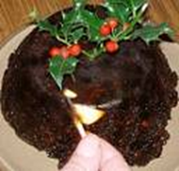
Christmas in Britain
Read and translate – use the dictionary
Christmas is the day when the Christ was born. It is the biggest festival of the year. On Christmas Eve (December 24) people decorate Christmas trees by candles, gold balls and a lot of sweets. Stockings are hung up. Children believe they will be filled by Father Christmas. On Christmas Day (December 25) children open the presents. Christmas dinner consists of roast turkey, roast potatoes and Christmas pudding

Slide 9
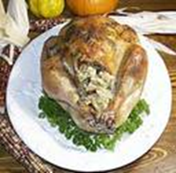
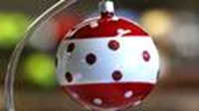
Christmas in Britain
Christmas is the day when the Christ was born. It is the biggest festival of the year. On Christmas Eve (December 24) people decorate Christmas trees by candles, gold balls and a lot of sweets. Stockings are hung up. Children believe they will be filled by Father Christmas. On Christmas Day (December 25) children open the presents. Christmas dinner consists of roast turkey, roast potatoes and Christmas pudding

Slide 10
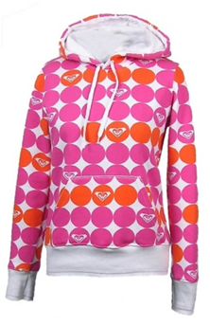
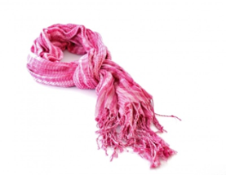
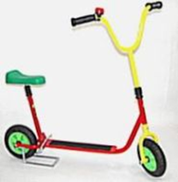
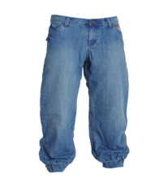
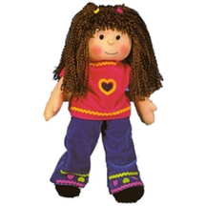
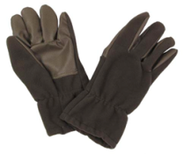
Christmas presents
What do you get at Christmas ?
What do you give at Christmas ?
I get presents from my parents.
I get a T-shirt from my mum.
I get a scooter from my dad.
I get jeans from my grandma.
I get a doll from my sister.
I give presents to my parents.
I give a scarf to my mother.
I give a tie to my father.
I give a train to my brother.
I give gloves to my grandpa.

Slide 11
Christmas
Write a Christmas a card
Sing a Christmas song
24 th December – Christmas Eve
25 th December – Christmas Day
26 th December – Boxing Day
I wish you merry Christmas
and
a happy New Year !
Jingle Bells
Jingle bells! Jingle bells!
Jingle all the way!
Oh, what fun
It is to ride
In a one- horse open sleigh !

