Slide 1
DAYS OF THE WEEK

Slide 2
Find days of the week and write them.
W | M | O | N | D | A | Y | X | T | C
E | B | S | I | W | F | L | S | H | O
D | K | U | L | Y | R | Z | A | U | Q
N | S | N | A | M | I | N | T | R | D
E | Z | D | T | B | D | H | U | S | I
S | W | A | G | J | A | V | R | D | P
D | R | Y | N | X | Y | M | D | A | G
A | I | T | U | E | S | D | A | Y | F
Y | J | E | F | B | A | L | Y | K | C
___________________________________________________________________________________________

Slide 3
Make sentences.
Mondays Bean has eleven at Science o’clock On.
Art o’clock has Bean On at Tuesdays one.
eight has Sport On o’clock at Bean Wednesdays.
On Bean nine Thursdays has History at o’clock.
Bean at Computer o’clock On has Fridays two.
Has On o’clock Music three Bean Saturdays at.
At five On Bean Sundays o’clock has Swimming.

Slide 4
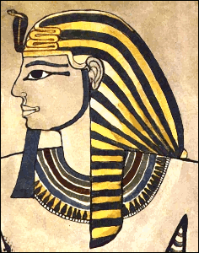
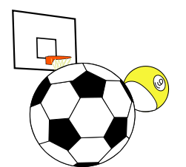
Do you remember? What day of the week is it?
Mondays
Wednesdays
Fridays
Tuesdays
Thursdays
Saturdays
Sundays
Notes:
[cit. 2012-2-24]. Obrázek dostupný pod licencí GNU Free Documentation Licence na www:
http://www.pdclipart.org/displayimage.php?album=search&cat=0&pos=0
http://www.pdclipart.org/displayimage.php?album=search&cat=0&pos=19
http://www.pdclipart.org/displayimage.php?album=search&cat=0&pos=8
http://www.pdclipart.org/displayimage.php?album=search&cat=0&pos=5
http://www.pdclipart.org/displayimage.php?album=search&cat=0&pos=10
http://www.pdclipart.org/displayimage.php?album=search&cat=0&pos=7

